Slide 1

Smartphone-Controlled Robotic Vacuum Cleaner using Arduino Embedded Platform
Bachelor of Technology (B. Tech.)
Computer and Communication Engineering
19CCE384 – Design and Innovation Lab
Batch ID – 111
S. No | Name | Roll Number
1 | B Ambareesh | CB.EN.U4CCE20006
2 | Narendran S | CB.EN.U4CCE20036
3 | Pabbathi Greeshma | CB.EN.U4CCE20040
4 | Santosh | CB.EN.U4CCE20053

Slide 2

Problem Statement
To design and implement an autonomous vacuum robot that can perform dry and wet cleaning of floors with obstacle avoidance, collision detection, status display, and automatic system features using Arduino Uno, motors, sensors, and a smartphone app for remote control and monitoring.

Slide 3
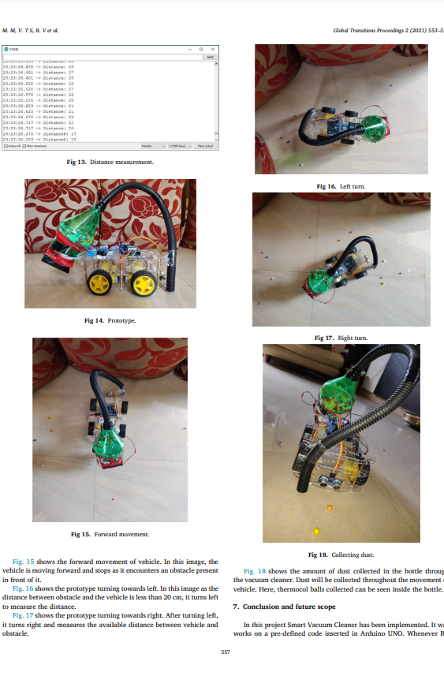

Literature Survey – Paper I: ScienceDirect
An autonomous vacuum cleaner system using an RC car with an ultrasonic sensor and a vacuum cleaner attached is proposed.
The vacuum cleaner is designed with a CPU fan and a pipe attached to the mouth of the bottle, and the entire system runs on batteries.
The system measures the distance between the obstacle and the car using an ultrasonic sensor, and the car moves in the direction where the distance is more to avoid collisions.
The algorithm is simple, cost-effective, and requires no human intervention.
The comparison with existing algorithms shows that the proposed prototype is easier to debug and requires no user interaction.

Slide 4

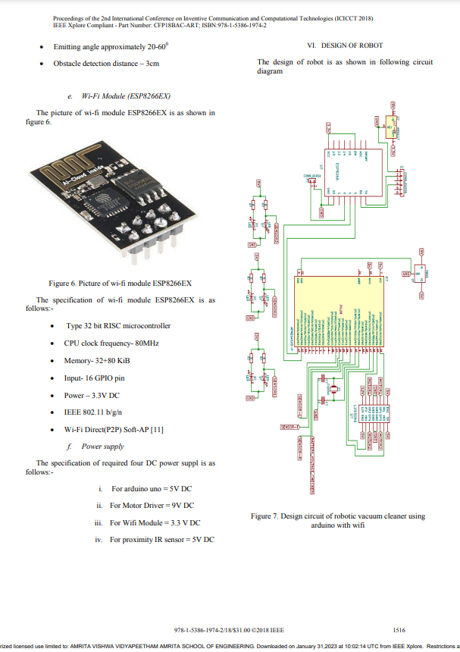
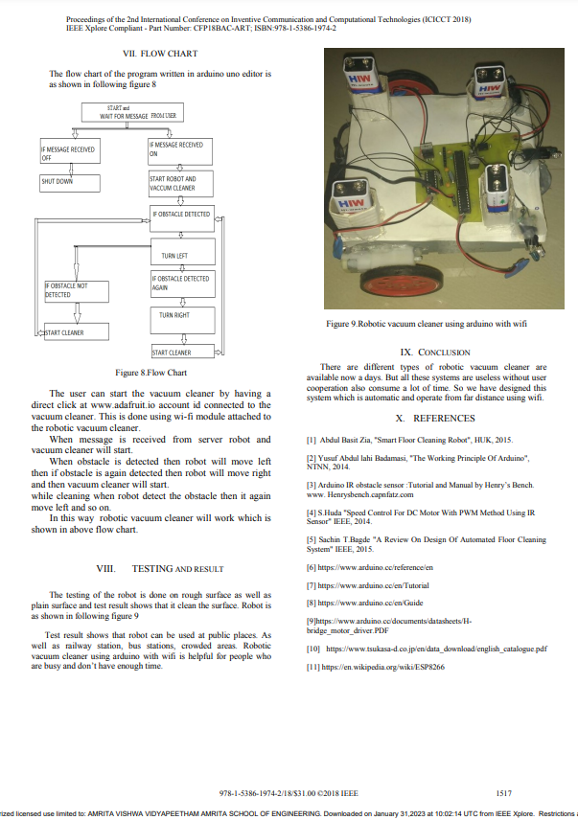
Literature Survey – Paper II: IEEE
This literature survey discusses the popularity of robotic cleaners in cleaning applications.
Different robotic cleaners use varying mechanisms to clean.
The objective of this work is to provide a solution using local resources.
The novelty of the work is a smartphone-controlled robotic vacuum cleaner using Arduino with IR sensor and motor driver IC.
The robot has been tested on rough and plain surfaces and shown effective results.
It can be used in public places and operated through Wi-Fi.

Slide 5
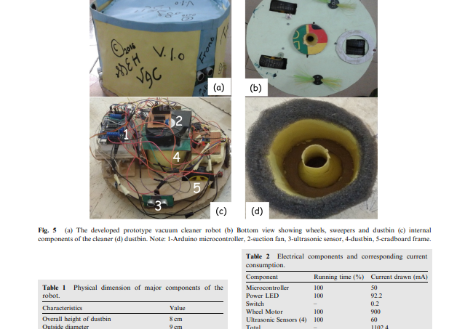

Literature Survey – Paper III: Elsevier
Modern households aim to reduce time spent on house chores via automation. Vacuum cleaners are efficient but often noisy and bulky for everyday use.
A compact robotic vacuum cleaner was developed for home and office use. The disk-shaped robot is controlled by an Arduino microcontroller.
It navigates using rear wheels and a front caster wheel, with ultrasonic sensors for obstacle detection. The robot is powered by a 28.8V DC battery and can work continuously for two hours.
Its cleaning mechanism includes two sweepers, a cooling fan, and a retractable dustbin. The robot's lightweight design makes it easy to maneuver in its environment.
The robot was fabricated from computer scraps and ultrasonic sensors, making it relatively cheap. The effectiveness of the robot's design was evaluated, with a patterned algorithm for room navigation.

Slide 6
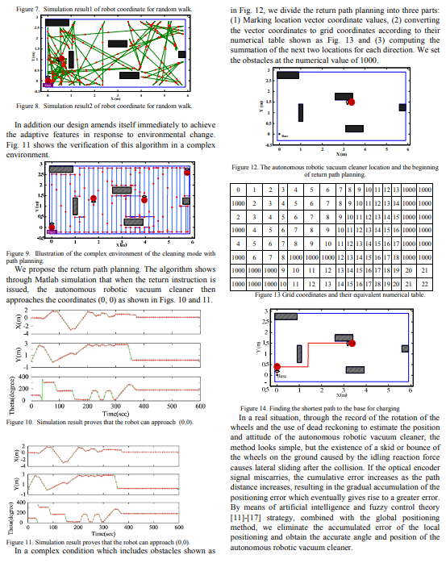

Literature Survey – Paper IV: IEEE
Existing robotic vacuum cleaners primarily rely on infrared emission sensors and embedded computing systems to plan the return path.
Few methods propose return path planning, which may lead to power exhaustion in complex environments.
This paper proposes a new algorithm that combines wheel-type robot kinematics with a projection determined from the real-time location of the cleaner.
The proposed algorithm divides the direction into eight directions and continuously computes the shortest path back to the base.
The authors also provide an algorithm to manage the battery of the robotic vacuum cleaner and ensure it returns to base for charging before continuing the cleaning task.
The experiment results demonstrate the effectiveness of the proposed algorithm in both simple and complex environments, allowing for efficient cleaning path planning and automatic return to base for recharging.

Slide 7



Highlights of Novel Ideas
Customizable Mobile Application: Develop a mobile application that allows users to customize cleaning settings, schedules, and preferences according to their specific needs. Real-time feedback and remote-control features can also be incorporated, enabling users to monitor and control the robot from anywhere.
Multi-Language Support: Implement multi-language support in the mobile application and the robot's user interface. This allows users from diverse linguistic backgrounds to interact with and control the vacuum cleaner using their native language, enhancing accessibility and user experience.
Simplified Distance Measurement: Integrate a servo motor mechanism with sensor input to simplify distance measurement. This can optimize power management and reduce complexity by providing accurate minimum distance measurements. The servo motor can assist in precise positioning and improve the robot's navigation capabilities.

Slide 8
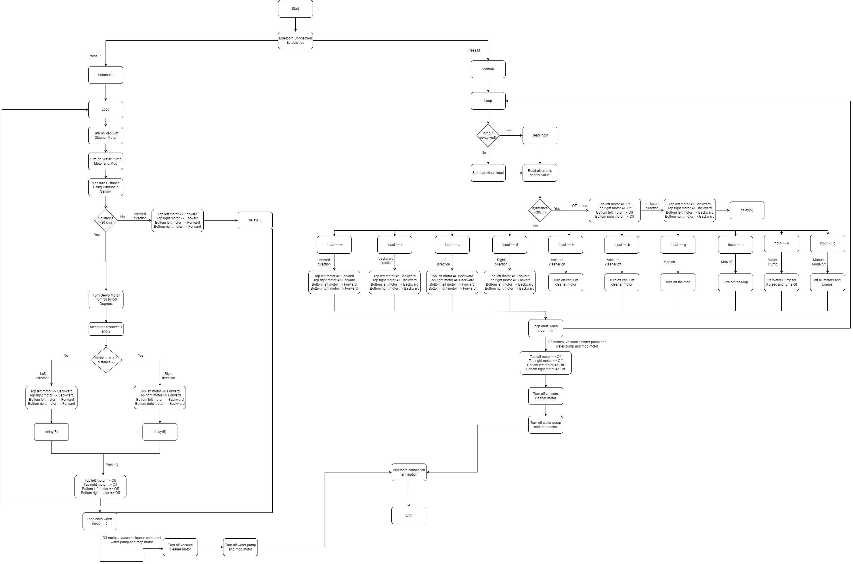
Algorithm Flowchart

Slide 9
Tools, Hardware & Software Used
Serial Number​ | Component Name​ | Purpose​ | Quantity​
1​ | 12V Rechargeable Lead-Acid Battery​ | Power Source​ | 1​
2​ | 9V Battery with Connector Clips​ |  | 5
3​ | Arduino Uno with USB Cable​ | Embedded Control Board​ | 1​
4​ | HC-05 Bluetooth Transceiver Module with TTL Outputs and Base​ | Communication Protocol​ | 1​
5​ | HC-SR04 Ultrasonic Module Distance Measuring Transducer Sensor​ | Sensor Data Obtained From​ | 1​
6​ | 7805 5V Fixed Linear Voltage Regulator IC​ | Actuator in Vacuum Cleaner and Remote Control (RC) Car​ | 1​
7​ | RS775 High RPM Torque 12V Brushed DC Motor |  | 1​
8​ | Battery Operated (BO) 10 RPM Gear DC Motor for Robot​ |  | 2​
9​ | SG90 Micro Servo Motor – 180 Degree Rotation​ |  | 1​
10​ | L298N Motor Driver Module​ |  | 2​
11​ | 65 mm BO Motor Wheel for Smart Car Arduino Robotics​ | Construction Material in Remote Control (RC) Car​ | 2​
12​ | Metal Caster Bearing Wheel​ |  | 2​
13​ | Mini Aquarium Water Pump R385​ | Actuator in Mopping System​ | 1​
14​ | PVC Pipe​ | Construction Material in Mopping System​ | 1 Meter​
15​ | Single Pole Double Throw (SPDT) Switch​ | Turn ON/OFF RC Car and Mop/Vacuum System | 2​
16​ | Pre-Fabricated Printed Circuit Board (PCB) | Build Electronic Circuits​ | 1
17​ | Jumper Wires Set​ (MM, FF, MF) |  | As Per Requirement​
18​ | Arduino IDE​ | Integrated Development Environment ​ | Offline​
19​ | MIT App Inventor​ | Interface to Appropriate Display​ | Online​
20​ | Fritzing​ | Hardware Simulation Platform​ | Offline​
21​ | Tinker CAD​ |  | Online​

Slide 10

Timeline (Monthly Commitment)
Feb.–Mar.
Requirement Gathering and Analysis – This stage involves identifying the requirements for the vacuum cleaner and smartphone application.
March
System Design – This stage involves designing the hardware and software components of the system, including the circuit diagrams, algorithms, and smartphone application interface.
Apr.–May
Development – This stage involves coding the Arduino program, developing the smartphone application, and building the robotic vacuum cleaner.
Apr.–May
Testing – This stage involves testing the functionality of the vacuum cleaner, the smartphone application, and the communication between the two.
May–June
User Manual Creation – This stage involves preparing the user manual that explains how to operate the vacuum cleaner and smartphone application.

Slide 11

Future Scope
The chassis can be built on a PVC polymer. This will reduce the overall weight of the system and the suction part can be automated using Programmable Logic Control for the sequence of operation.
The setup can be fully automated without manual interventions and the dust can be collected using vacuum removal.
Image processing technique can be implied to analyze the surface cleaning efficiency using a high-quality onboard camera.
Germless cleaning using UV exposure installed on the vehicle.

Slide 12
References
Serial Number | Journals & Conference Papers | Websites
1 | Arduino-Based Cleaner Robot, International Journal of Engineering Research & Technology (IJERT), ICIATE - 2017 Conference Proceedings, Special Issue - 2017, ISSN: 2278-0181 | Arduino Home Page - Hardware | Software | Cloud | Documentation | Community | Blog | About
2 | Manasa M, Vidyashree T S, Bindushree V, Sanjana Rao, Gowra P S, Smart vacuum cleaner, Global Transitions Proceedings, Volume 2, Issue 2, 2021, Pages 553-558, ISSN 2666-285X | Circuit Digest, Microcontroller-Based Projects, Build your Own Arduino-Based Smart Vacuum Cleaner Robot for Automatic Floor Cleaning
3 | Mohd Annuar, Khalil & Dahari, R.M. & Harun, Mohamad Haniff & Sapiee, Mohd & ab hadi, Nik. (2018). Design and implementation of vacuum cleaner robot using Arduino and smartphone. Journal of Engineering and Applied Sciences. 13. 5692-5698. 10.3923/jeasci.2018.5692.5698. | Circuit Digest, Microcontroller-Based Projects, DIY Smart Vacuum Cleaning Robot using Arduino
4 | P. B. Jarande, S. P. Murakar, N. S. Vast, N. P. Ubale and S. S. Saraf, "Robotic Vacuum Cleaner Using Arduino with Wi-Fi," 2018 Second International Conference on Inventive Communication and Computational Technologies (ICICCT), Coimbatore, India, 2018, pp. 1513-1517, DOI: 10.1109/ICICCT.2018.8473256. | Circuit Digest, Microcontroller-Based Projects, Distance Measurement using Ultrasonic Sensor and Arduino
5 | T.B. Asafa, T.M. Afonja, E.A. Olaniyan, H.O. Alade, Development of a vacuum cleaner robot, Alexandria Engineering Journal, Volume 57, Issue 4, 2018, Pages 2911-2920, ISSN 1110-0168 | Components 101, Servo Motor SG-90 and MG90S Metal Gear Micro Servo Motor
6 | Y. -W. Bai and M. -F. Hsueh, "Using an adaptive iterative learning algorithm for the planning of the path of an autonomous robotic vacuum cleaner," The 1st IEEE Global Conference on Consumer Electronics 2012, Tokyo, Japan, 2012, pp. 401-405, DOI: 10.1109/GCCE.2012.6379640. | Last Minute Engineers, Control DC, Stepper & Servo with L293D Motor Driver Shield & Arduino

